Slide 1
Mavzu: Koshi teoremasi, Lopital qoidasi

Slide 2



Slide 3
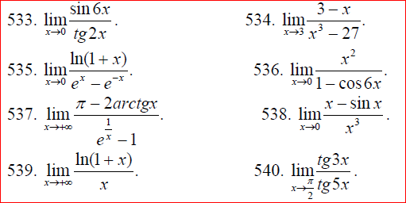

Slide 4
