Slide 1
Sodda ratsional kasrlar va ularni integrallash. To’g’ri ratsional kasrlarni itegrallash

Slide 2
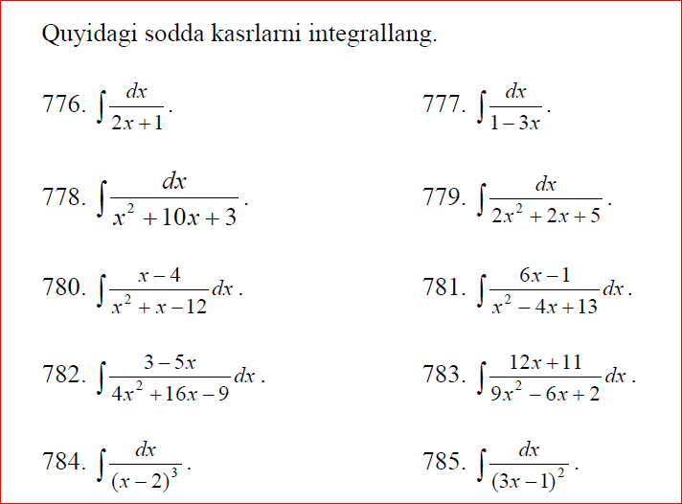

Slide 3
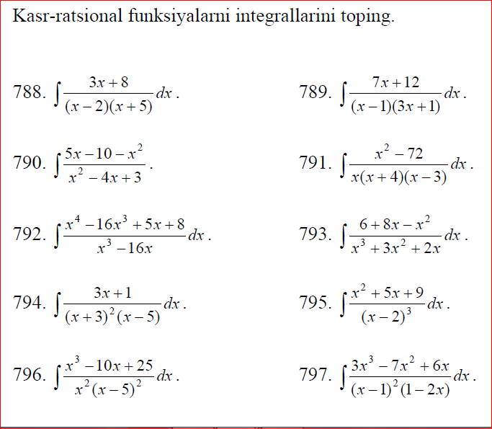

Slide 4
