Slide 1
Chiziqli vektor fazo va ularning xossalari
Vektor fazo haqida tushuncha
Vektor fazoning turi
Vektor fazoning xossalari
Vektor fazoga misollar
Izomorfizm
Vektor fazolar izomorfizimi

Slide 2
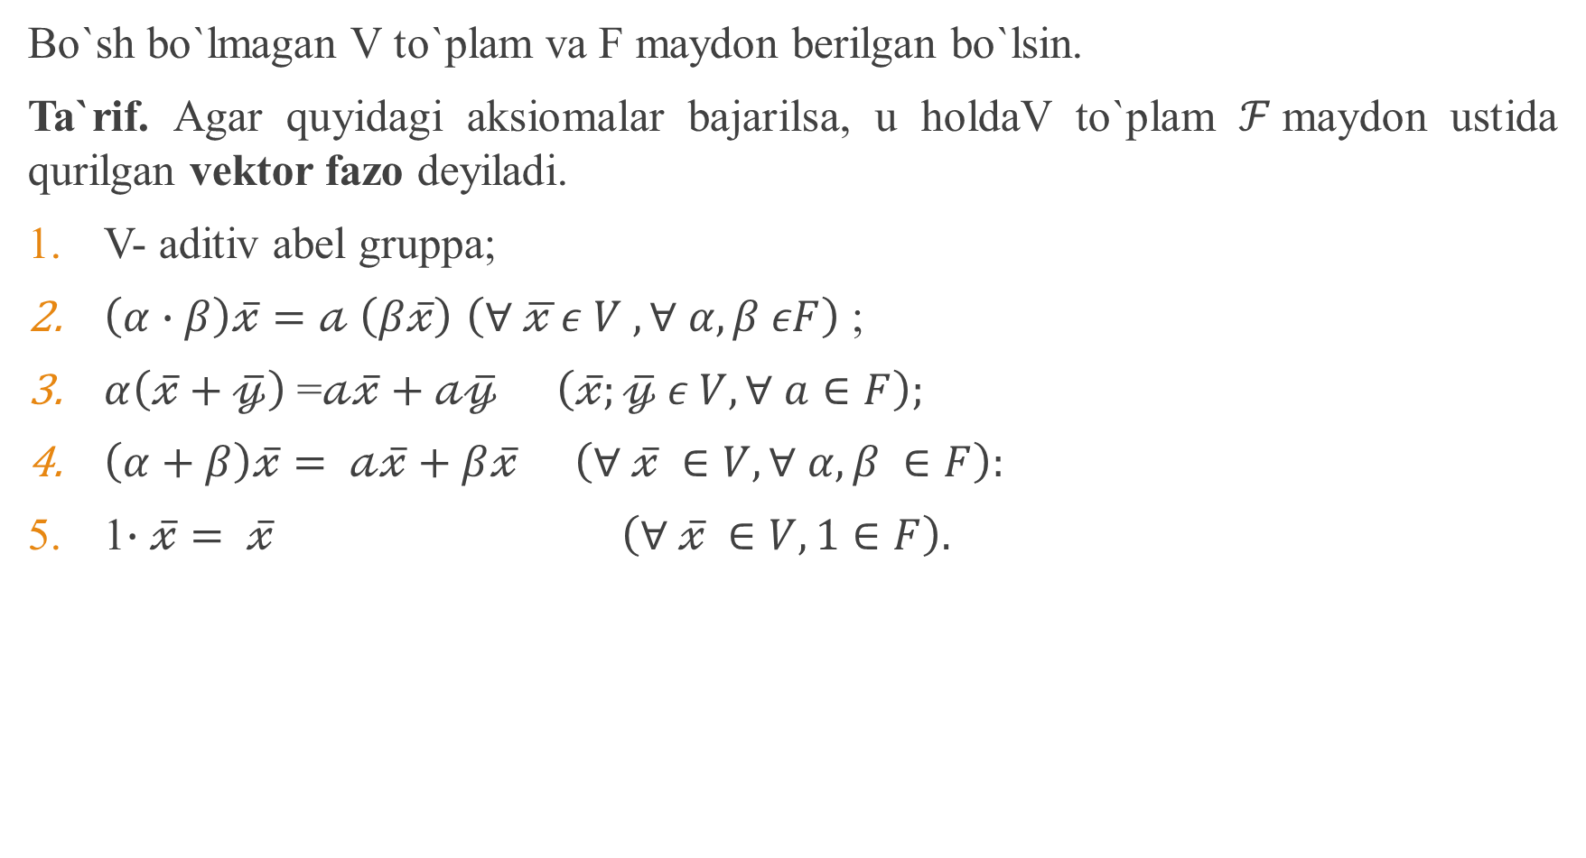
Bo`sh bo`lmagan V to`plamva F maydonberilganbo`lsin.
Ta`rif. Agar quyidagiaksiomalarbajarilsa, u holdaVto`plam$ℱ$maydonustidaqurilganvektorfazodeyiladi.
V- aditivabelgruppa;
$\left(α∙β\right)\overline{𝓍}=𝒶$$\left(β\overline{𝓍}\right)$$\left(∀ \overline{𝓍 }ε V , ∀ α, β εF\right)$;
$α\left(\overline{𝓍}+\overline{𝓎}\right)$ =$𝒶\overline{𝓍}+𝒶\overline{𝓎}$$\left(\overline{𝓍};\overline{𝓎} ε V, ∀ a∈F\right);$
$\left(α+β\right)\overline{𝓍}= 𝒶\overline{𝓍}+β\overline{𝓍}$$\left(∀ \overline{𝓍} ∈V, ∀ α,β ∈F\right):$
1$∙\overline{𝓍}= \overline{𝓍} \left(∀ \overline{𝓍} ∈V, 1∈F\right).$

Slide 3
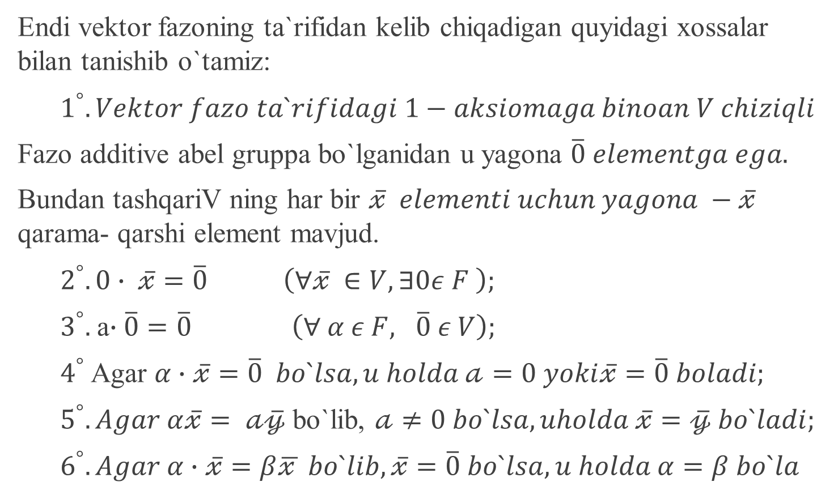
Endi vektorfazoningta`rifidankelibchiqadiganquyidagixossalarbilantanishibo`tamiz:
$1^{°}. Vektor fazo ta`rifidagi 1−aksiomaga binoan V chiziqli$
Fazo additive abelgruppabo`lganidan u yagona$\overline{0} elementga ega.$
BundantashqariVningharbir$\overline{𝓍} elementi uchun yagona −\overline{𝓍}$qarama- qarshi element mavjud.
$2^{°}. 0∙ \overline{𝓍}=\overline{0} \left(∀\overline{𝓍} ∈V, ∃0ε F \right);$
$3^{°}.$a$∙\overline{0}=\overline{0} \left(∀ α ε F, \overline{0} ε V\right);$
$4^{°}$Agar $α∙\overline{𝓍}=\overline{0} bo`lsa, u holda 𝒶=0 yoki\overline{𝓍}=\overline{0} boladi;$
$5^{°}. Agar α\overline{𝓍}= 𝒶\overline{𝓎}$bo`lib, $𝒶≠0 bo`lsa, uholda \overline{𝓍}=\overline{𝓎} bo`ladi;$
$6^{°}. Agar α∙\overline{𝓍}=β\overline{𝓍 } bo`lib, \overline{𝓍}=\overline{0} bo`lsa, u holda α=β bo`la$

Slide 4
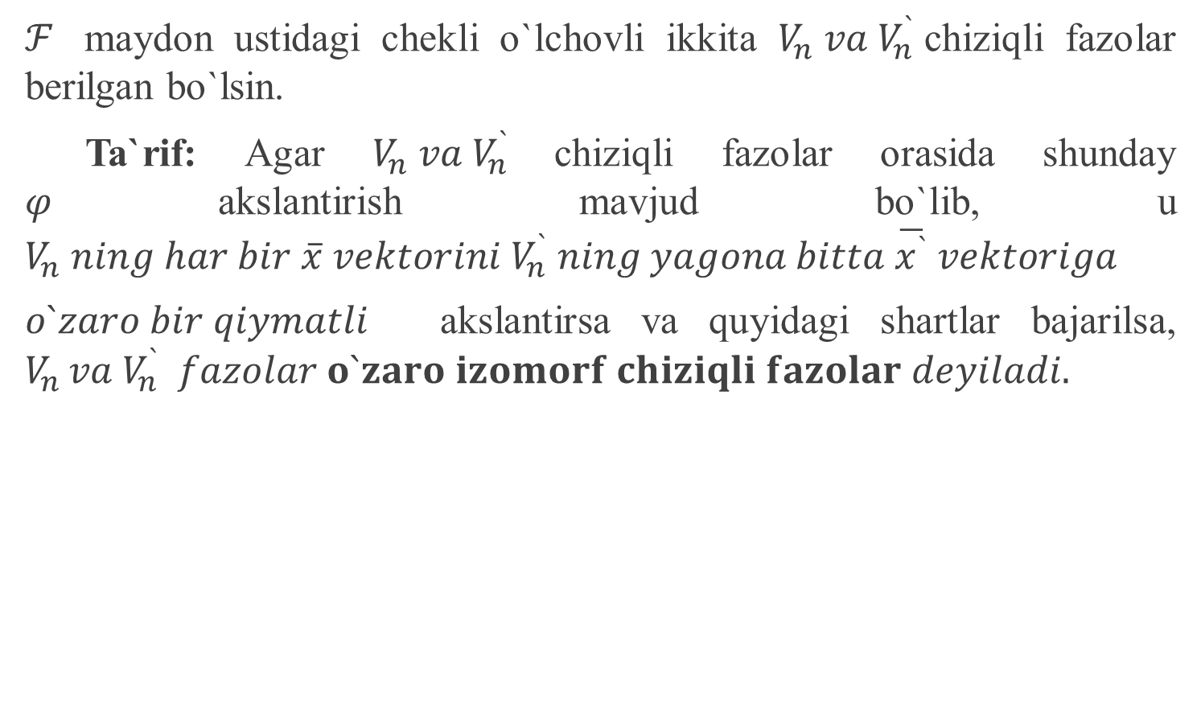
$ℱ$maydonustidagicheklio`lchovliikkita$V_{n} va V_{n}^{`}$chiziqlifazolarberilganbo`lsin.
Ta`rif: Agar $V_{n} va V_{n}^{`}$chiziqlifazolarorasidashunday$φ$akslantirishmavjudbo`lib, u $V_{n} ning har bir \overline{x} vektorini V_{n}^{`} ning yagona bitta \overline{x^{`}} vektoriga$
$o`zaro bir qiymatli$akslantirsavaquyidagishartlarbajarilsa, $V_{n }va V_{n}^{`} fazolar o`zaro izomorf chiziqli fazolar deyiladi.$

Slide 5
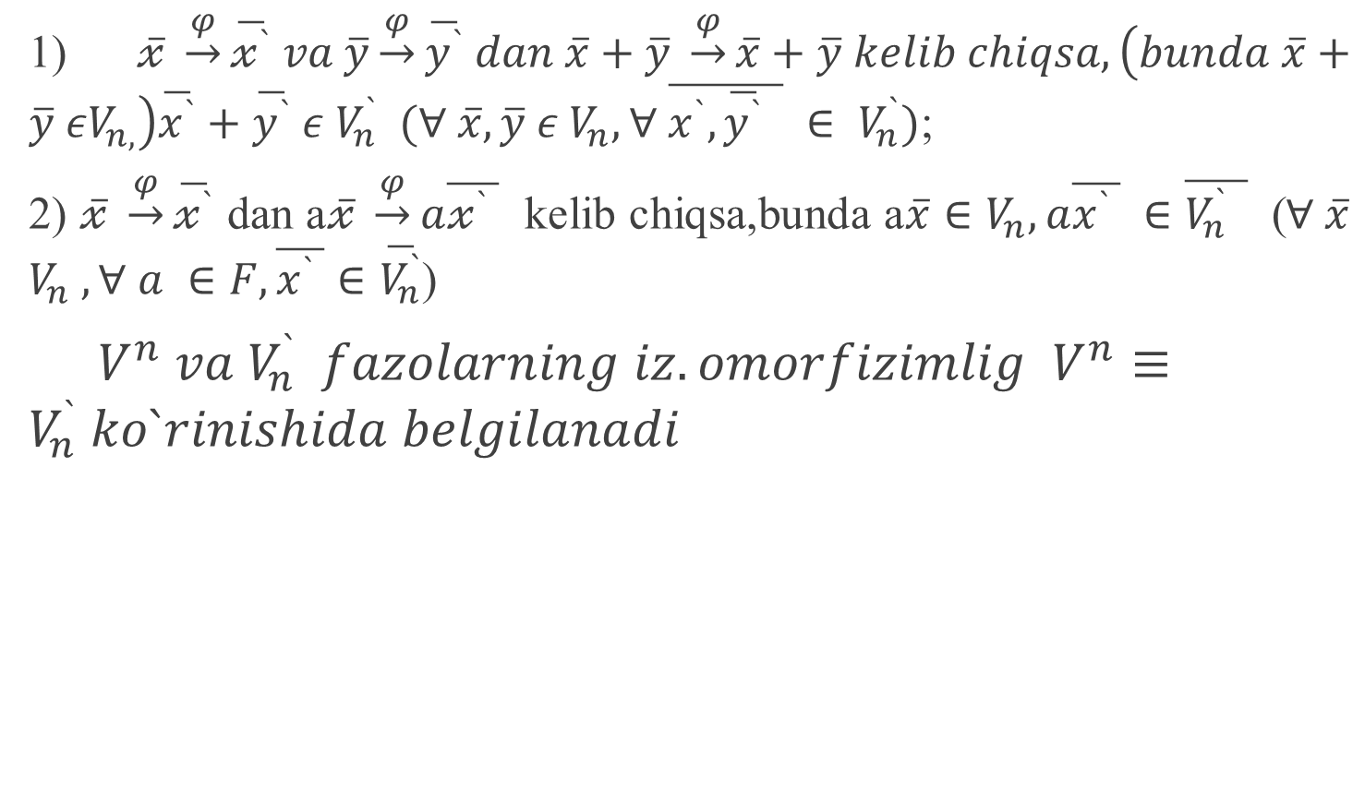
1) $\overline{𝓍} \underset{→}{φ}\overline{𝓍^{`}} va \overline{y}\underset{→}{φ}\overline{y^{`}} dan \overline{x}+\overline{y} \underset{→}{φ}\overline{x}+\overline{y} kelib chiqsa, \left(bunda \overline{x}+\overline{y} εV_{n,}\right)\overline{x^{`}}+\overline{y^{`}} ε$$V_{n}^{`} (∀ \overline{x},\overline{y} ε V_{n}, ∀ \overline{x^{`},\overline{y^{`}} } ∈ V_{n}^{`})$;
2)$\overline{𝓍} \underset{→}{φ}\overline{𝓍^{`}}$dan a$\overline{𝓍} \underset{→}{φ}a\overline{𝓍^{`} }$kelibchiqsa,bunda a$\overline{x}∈V_{n}, a\overline{x^{`} } ∈\overline{V_{n}^{`} }$ ($∀ \overline{x}$$V_{n} , ∀ a ∈F, \overline{x^{`} }∈\overline{V_{n}^{`}}$)
$V^{n} va V_{n}^{`} fazolarning iz.omorfizimlig V^{n}≡V_{n}^{`} ko`rinishida belgilanadi$

Slide 6
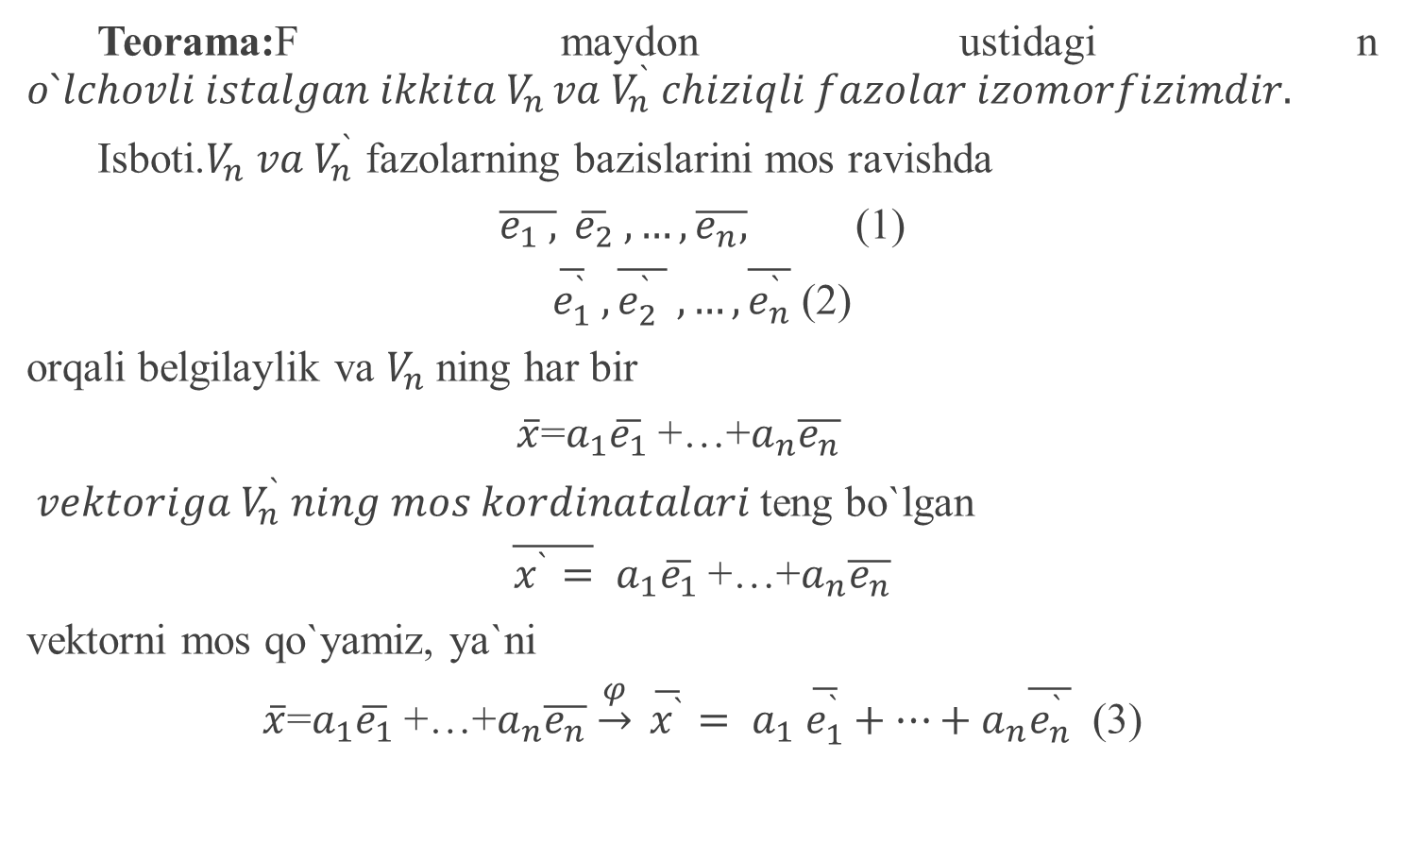
Teorama:Fmaydonustidagi n $o`lchovli istalgan ikkita V_{n }va V_{n}^{`} chiziqli fazolar izomorfizimdir.$
Isboti.$V_{n} va V_{n}^{`}$fazolarningbazislarinimosravishda
$\overline{e_{1} ,} \overline{e_{2}} ,…,\overline{e_{n},}$ (1)
$\overline{e_{1}^{`}} ,\overline{e_{2}^{`} } ,…,\overline{e_{n}^{`}}$ (2)
orqalibelgilaylikva$V_{n}$ningharbir
$\overline{x}$=$a_{1}\overline{e_{1}}$ +…+$a_{n}\overline{e_{n}}$
$vektoriga V_{n}^{`} ning mos kordinatalari$tengbo`lgan
$\overline{x^{`}=} a_{1}\overline{e_{1}}$ +…+$a_{n}\overline{e_{n}}$
vektornimosqo`yamiz, ya`ni
$\overline{x}$=$a_{1}\overline{e_{1}}$ +…+$a_{n}\overline{e_{n}}$$\underset{→}{φ} \overline{x^{`}}= a_{1} \overline{e_{1}^{`}}+…+a_{n}\overline{e_{n}^{`}}$ (3)

Slide 7
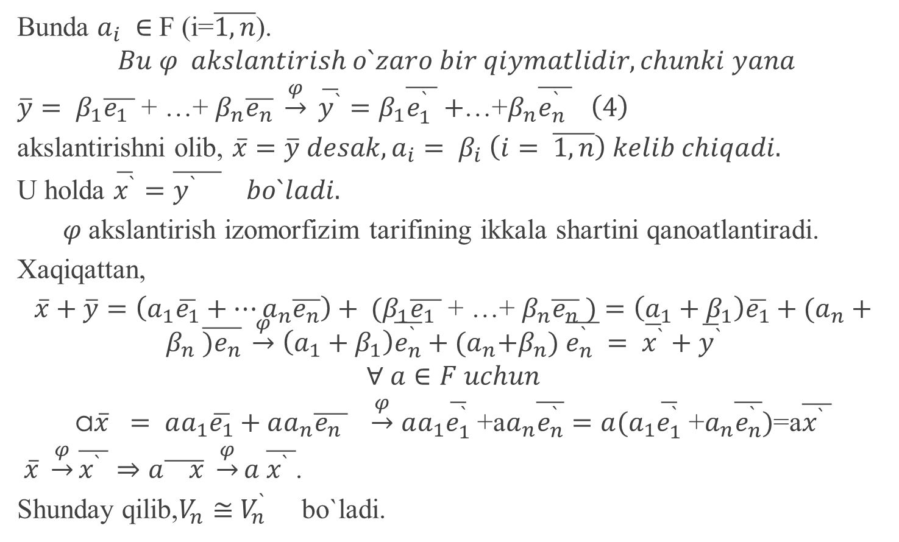
Bunda $a_{i} ∈$F (i=$\overline{1,n}$).
$$Bu φ akslantirish o`zaro bir qiymatlidir, chunki yana$$
$\overline{y}= β_{1}\overline{e_{1} }$ + …+ $β_{n}\overline{e_{n}} \underset{→}{φ} \overline{y^{`}}=β_{1}\overline{e_{1}^{`} }+$…+$β_{n}\overline{e_{n}^{`} } \left(4\right)$
akslantirishniolib, $\overline{x}=\overline{y} desak, a_{i}= β_{i} \left(i= \overline{1,n}\right) kelib chiqadi.$
U holda$\overline{x^{`}}=\overline{y^{`} } bo`ladi.$
$φ$akslantirishizomorfizimtarifiningikkalashartiniqanoatlantiradi.
Xaqiqattan,
$\overline{x}+\overline{y}=\left(a_{1}\overline{e_{1}}+…a_{n}\overline{e_{n}}\right)+ {(β}_{1}\overline{e_{1} }$ + …+ $β_{n}\overline{e_{n}} )=\left(a_{1}+β_{1}\right)\overline{e_{1}}+(a_{n}+β_{n} \overline{{)e}_{n}} \underset{→}{φ}$$\left(a_{1}+β_{1}\right)\overline{e_{n}^{`}}+{(a}_{n}+β_{n}) \overline{e_{n}^{`} }= \overline{x^{`}}+\overline{y^{`}}$
$$∀ a∈F uchun$$
a$\overline{x} = aa_{1}\overline{e_{1}}+aa_{n}\overline{e_{n} } \underset{→}{φ}$$aa_{1}\overline{e_{1}^{`}}$ +a$a_{n}\overline{e_{n}^{`}}=a(a_{1}\overline{e_{1}^{`}} \text{+}a_{n}\overline{e_{n}^{`}})$=a$\overline{x^{`} }$
$\overline{x} \underset{→}{φ}\overline{x^{`} }⇒a\overline{ x} \underset{→}{φ}a \overline{x^{`} }$.
Shundayqilib,$V_{n}$$≅$$V_{n}^{`}$ bo`ladi.

