Slide 1
Turli bazislardagi vektorlar, chiziqli operatorlar orasida bog`lanishlar. O`xshash matritsalar.

Slide 2
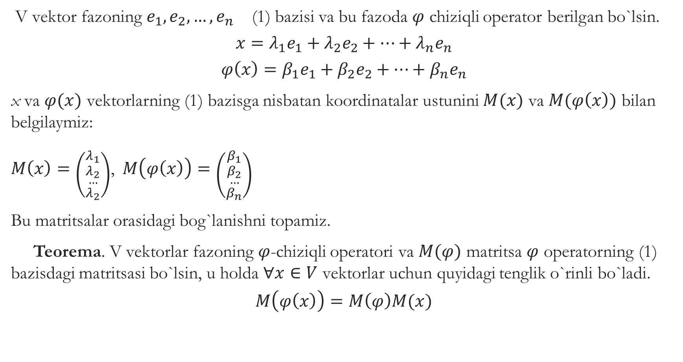
V vektor fazoning $e_{1},e_{2},…,e_{n}$ (1) bazisi va bu fazoda $φ$ chiziqli operator berilgan bo`lsin.
$$x=λ_{1}e_{1}+λ_{2}e_{2}+…+λ_{n}e_{n}$$
$$φ\left(x\right)=β_{1}e_{1}+β_{2}e_{2}+…+β_{n}e_{n}$$
x va $φ(x)$ vektorlarning (1) bazisga nisbatan koordinatalar ustunini $M(x)$ va $M(φ\left(x\right))$ bilan belgilaymiz:
$M\left(x\right)=\left({λ_{1} \atop \begin{aligned}λ_{2} \\ … \\ λ_{2}\end{aligned}}\right)$,$M\left(φ\left(x\right)\right)=\left({β_{1} \atop \begin{aligned}β_{2} \\ … \\ β_{n}\end{aligned}}\right)$
Bu matritsalar orasidagi bog`lanishni topamiz.
Teorema. V vektorlar fazoning $φ$-chiziqli operatori va $M(φ)$ matritsa $φ$ operatorning (1) bazisdagi matritsasi bo`lsin, u holda $∀x∈V$ vektorlar uchun quyidagi tenglik o`rinli bo`ladi.
$$M\left(φ\left(x\right)\right)=M\left(φ\right)M(x)$$

Slide 3

Isboti.
$M\left(φ\right)=\left({a_{11} a_{12}…a_{1n} \atop \begin{aligned}a_{21}a_{22}…a_{2n} \\ ……………… \\ a_{n1}a_{n2}…a_{nn}\end{aligned}}\right)$ bo`lsin,
u holda
$$φ\left(e_{1}\right)=a_{11}e_{1}+a_{21}e_{2}+…+a_{n1}e_{n}$$
$$φ\left(e_{2}\right)=a_{12}e_{1}+a_{22}e_{2}+…+a_{n2}e_{n}$$
……………………………………..
$$φ\left(e_{n}\right)=a_{1n}e_{1}+a_{2n}e_{2}+…+a_{nn}e_{n}$$
tengliklar o`rinli bo`ladi.
Agar
$$x=λ_{1}e_{1}+λ_{2}e_{2}+…+λ_{n}e_{n}$$
bo’lsa, u holda

Slide 4
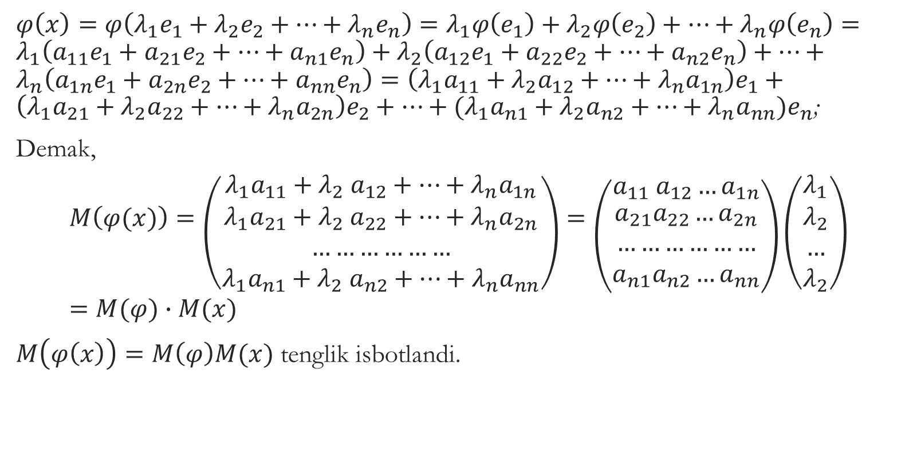
$φ\left(x\right)=φ\left(λ_{1}e_{1}+λ_{2}e_{2}+…+λ_{n}e_{n}\right)=λ_{1}φ\left(e_{1}\right)+λ_{2}φ\left(e_{2}\right)+…+λ_{n}φ\left(e_{n}\right)=λ_{1}\left(a_{11}e_{1}+a_{21}e_{2}+…+a_{n1}e_{n}\right)+λ_{2}\left(a_{12}e_{1}+a_{22}e_{2}+…+a_{n2}e_{n}\right)+…+λ_{n}\left(a_{1n}e_{1}+a_{2n}e_{2}+…+a_{nn}e_{n}\right)=\left(λ_{1}a_{11}+λ_{2}a_{12}+…+λ_{n}a_{1n}\right)e_{1}+\left(λ_{1}a_{21}+λ_{2}a_{22}+…+λ_{n}a_{2n}\right)e_{2}+…+{(λ}_{1}a_{n1}+λ_{2}a_{n2}+…+λ_{n}a_{nn})e_{n}$;
Demak,
$$M\left(φ(x)\right)=\left({{λ_{1}a}_{11}+λ_{2} a_{12}+…+λ_{n}a_{1n} \atop \begin{aligned}{λ_{1}a}_{21}+λ_{2} a_{22}+…+λ_{n}a_{2n} \\ ……………… \\ {λ_{1}a}_{n1}+λ_{2} a_{n2}+…+λ_{n}a_{nn}\end{aligned}}\right)=\left({a_{11} a_{12}…a_{1n} \atop \begin{aligned}a_{21}a_{22}…a_{2n} \\ ……………… \\ a_{n1}a_{n2}…a_{nn}\end{aligned}}\right)\left({λ_{1} \atop \begin{aligned}λ_{2} \\ … \\ λ_{2}\end{aligned}}\right)=M(φ)∙M(x)$$
$M\left(φ\left(x\right)\right)=M\left(φ\right)M(x)$ tenglik isbotlandi.

Slide 5
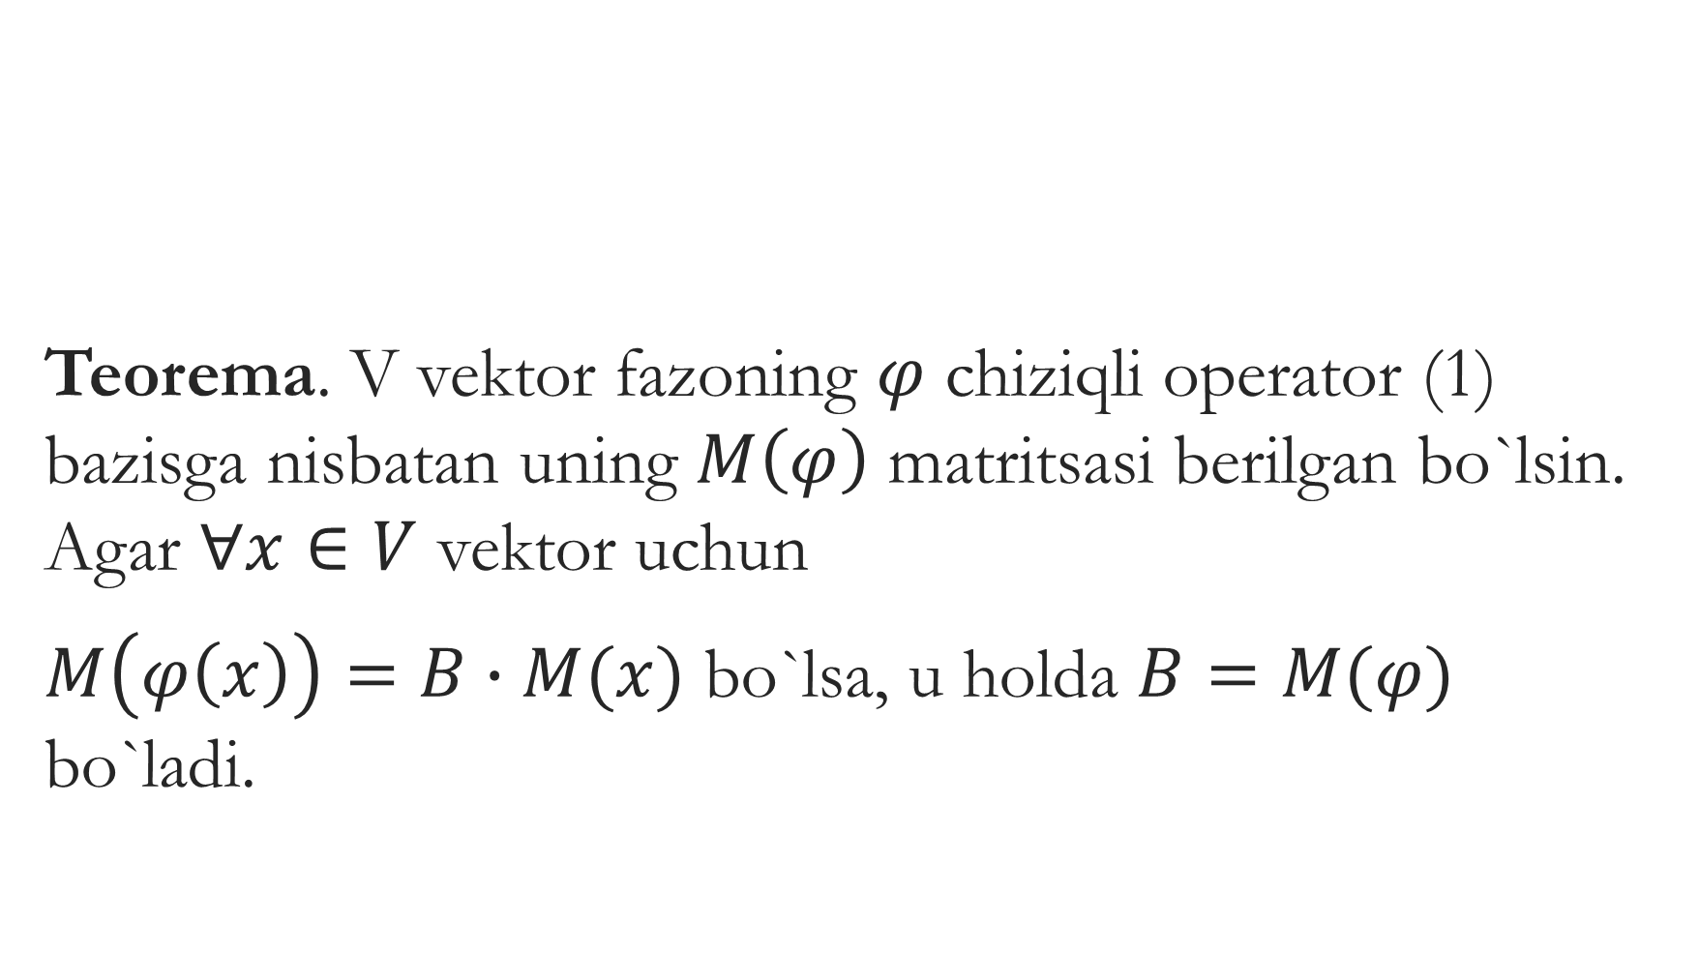
Teorema. V vektor fazoning $φ$ chiziqli operator (1) bazisga nisbatan uning $M\left(φ\right)$ matritsasi berilgan bo`lsin. Agar $∀x∈V$ vektor uchun
$M\left(φ\left(x\right)\right)=B∙M(x)$ bo`lsa, u holda $B=M(φ)$ bo`ladi.

Slide 6

Isboti.$M(φ)$ matritsaning aniqlanishiga ko`ra,
$M\left(φ\right)=M(M\left(φ\left(e_{1}\right)\right),M\left(φ\left(e_{2}\right)\right),…,M(φ\left(e_{n}\right))$ (1)
$M\left(φ\left(x\right)\right)=BM(x)$ ga $e_{1},e_{2},…,e_{n}$ vektorlarni ketma-ket qo`yib,
$M\left(φ\left(e_{1}\right)\right)=B∙M(e_{1})=B∙\left(\begin{aligned}{1 \atop 0} \\ 0 \\ … \\ 0\end{aligned}\right)=B^{1}$
$M\left(φ\left(e_{2}\right)\right)=B∙M(e_{2})=B∙\left(\begin{aligned}{1 \atop 0} \\ 0 \\ … \\ 0\end{aligned}\right)=B^{2}$ (2)
……………………………………………………..
$M\left(φ\left(e_{n}\right)\right)=B∙M(e_{n})=B∙\left(\begin{aligned}{1 \atop 0} \\ 0 \\ … \\ 0\end{aligned}\right)=B^{n}$
va (2) ga asosan, $M\left(φ\right)$ va B matritsalarning mos ustunlari ustma-ust tushadi. Demak, $M\left(φ\right)=B$

Slide 7
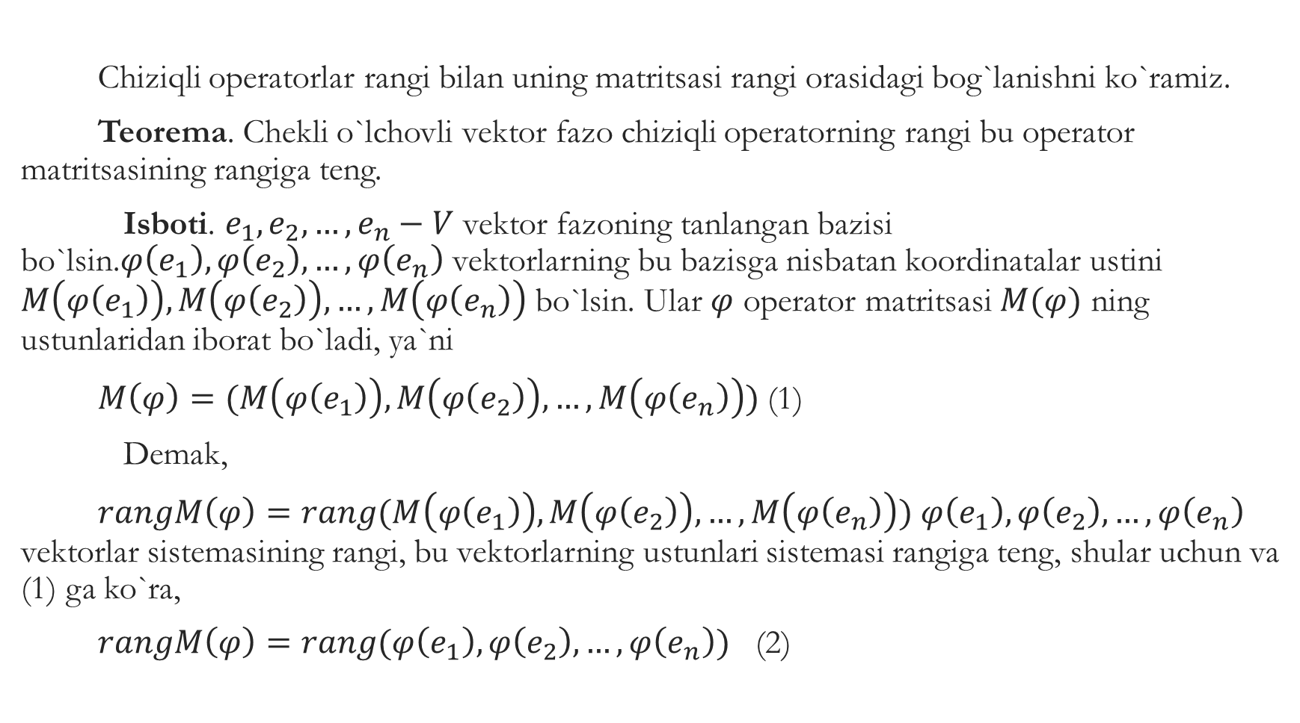
Chiziqli operatorlar rangi bilan uning matritsasi rangi orasidagi bog`lanishni ko`ramiz.
Teorema. Chekli o`lchovli vektor fazo chiziqli operatorning rangi bu operator matritsasining rangiga teng.
Isboti. $e_{1},e_{2},…,e_{n}−V$ vektor fazoning tanlangan bazisi bo`lsin.$φ\left(e_{1}\right),φ\left(e_{2}\right),…,φ\left(e_{n}\right)$ vektorlarning bu bazisga nisbatan koordinatalar ustini $M\left(φ\left(e_{1}\right)\right), M\left(φ\left(e_{2}\right)\right),…, M\left(φ\left(e_{n}\right)\right)$ bo`lsin. Ular $φ$ operator matritsasi $M(φ)$ ning ustunlaridan iborat bo`ladi, ya`ni
$M\left(φ\right)=(M\left(φ\left(e_{1}\right)\right), M\left(φ\left(e_{2}\right)\right),…, M\left(φ\left(e_{n}\right)\right))$ (1)
Demak,
$rangM\left(φ\right)=rang(M\left(φ\left(e_{1}\right)\right), M\left(φ\left(e_{2}\right)\right),…, M\left(φ\left(e_{n}\right)\right))$ $φ\left(e_{1}\right),φ\left(e_{2}\right),…,φ\left(e_{n}\right)$ vektorlar sistemasining rangi, bu vektorlarning ustunlari sistemasi rangiga teng, shular uchun va (1) ga ko`ra,
$rangM\left(φ\right)=rang(φ\left(e_{1}\right),φ\left(e_{2}\right),…,φ\left(e_{n}\right))$ (2)

Slide 8
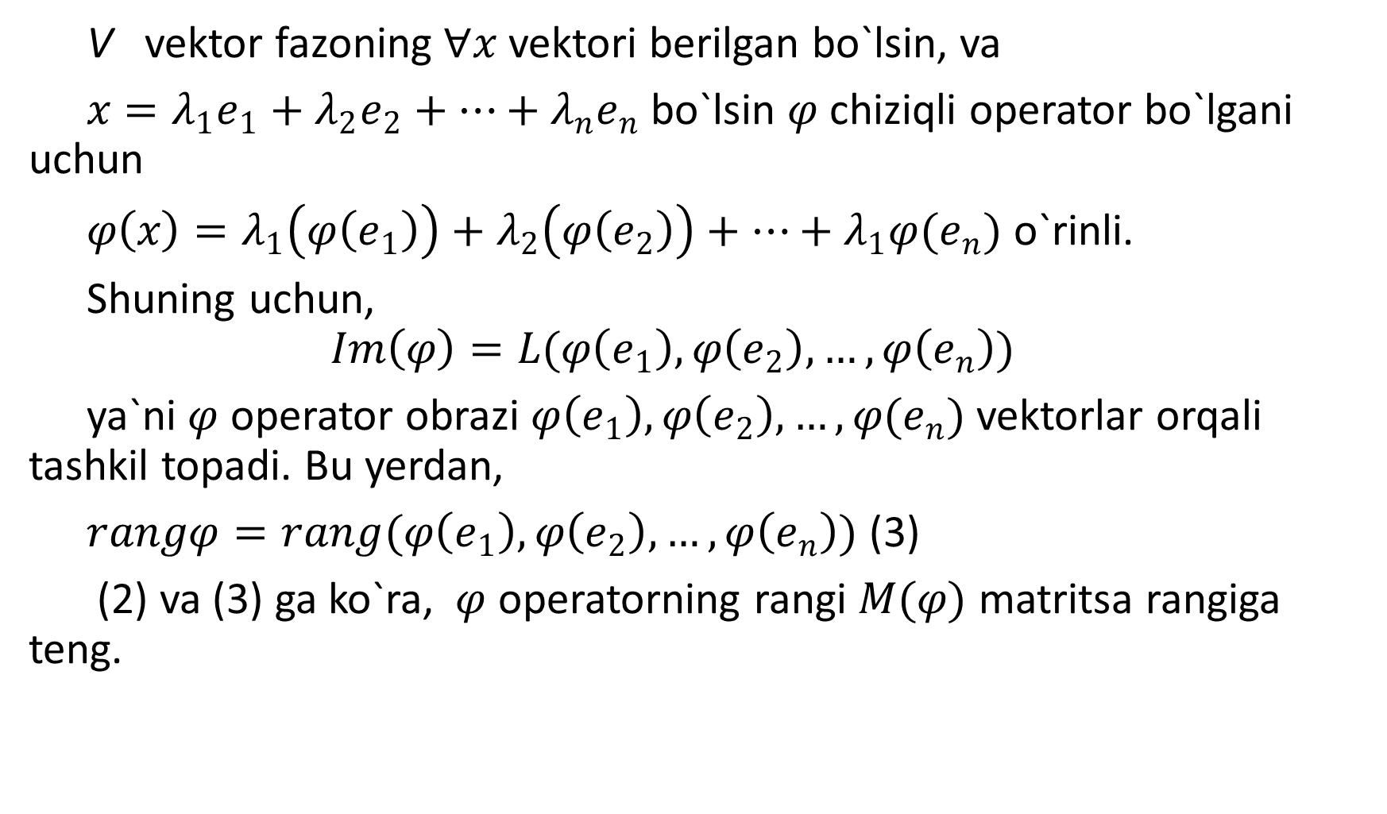
V vektor fazoning $∀x$ vektori berilgan bo`lsin, va
$x=λ_{1}e_{1}+λ_{2}e_{2}+…+λ_{n}e_{n}$ bo`lsin $φ$ chiziqli operator bo`lgani uchun
$φ\left(x\right)=λ_{1}\left(φ\left(e_{1}\right)\right)+λ_{2}\left(φ\left(e_{2}\right)\right)+…+λ_{1}φ(e_{n})$ o`rinli.
Shuning uchun,
$$Im\left(φ\right)=L(φ\left(e_{1}\right),φ\left(e_{2}\right),…,φ\left(e_{n}\right))$$
ya`ni $φ$ operator obrazi $φ\left(e_{1}\right),φ\left(e_{2}\right),…,φ(e_{n})$ vektorlar orqali tashkil topadi. Bu yerdan,
$rangφ=rang(φ\left(e_{1}\right),φ\left(e_{2}\right),…,φ\left(e_{n}\right))$ (3)
(2) va (3) ga ko`ra, $φ$ operatorning rangi $M(φ)$ matritsa rangiga teng.

Slide 9
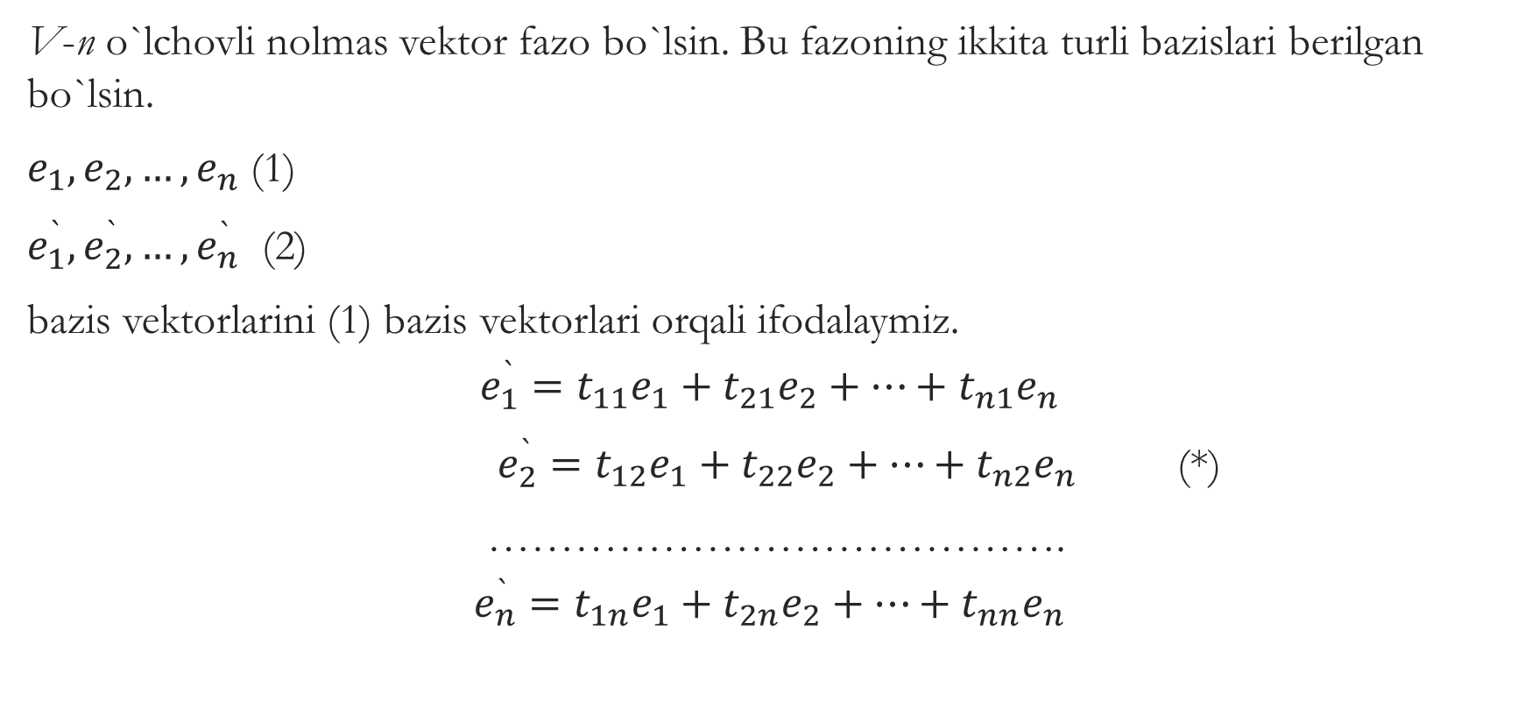
Turli bazislarga nisbatan berilgan vektorlarning ustun koordinatalari orasidagi bo`g`lanish.
V-n o`lchovli nolmas vektor fazo bo`lsin. Bu fazoning ikkita turli bazislari berilgan bo`lsin.
$e_{1},e_{2},…,e_{n}$ (1)
$e_{1}^{`},e_{2}^{`},…,e_{n}^{`}$ (2)
bazis vektorlarini (1) bazis vektorlari orqali ifodalaymiz.
$$e_{1}^{`}=t_{11}e_{1}+t_{21}e_{2}+…+t_{n1}e_{n}$$
$e_{2}^{`}=t_{12}e_{1}+t_{22}e_{2}+…+t_{n2}e_{n}$ (*)
………………………………….
$$e_{n}^{`}=t_{1n}e_{1}+t_{2n}e_{2}+…+t_{nn}e_{n}$$

Slide 10
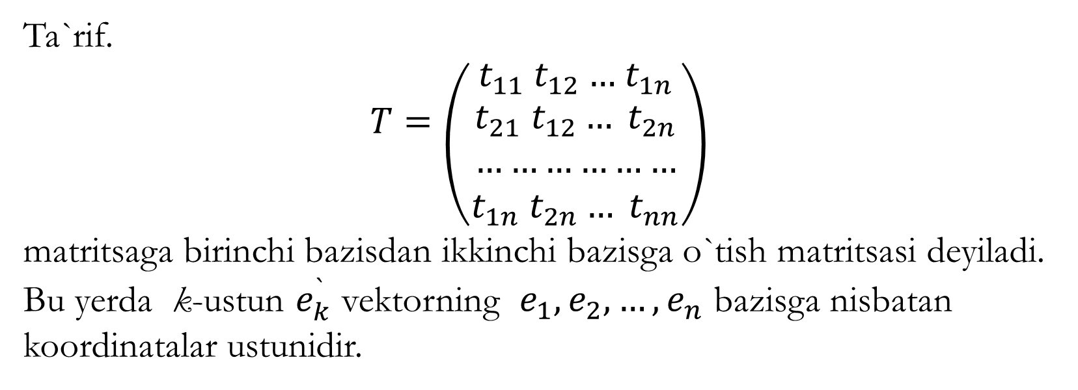
Ta`rif.
$$T=\left({t_{11} t_{12}…{ t}_{1n} \atop \begin{aligned}t_{21} t_{12}… t_{2n} \\ ……………… \\ t_{1n} t_{2n}… t_{nn}\end{aligned}}\right)$$
matritsaga birinchi bazisdan ikkinchi bazisga o`tish matritsasi deyiladi. Bu yerda k-ustun $e_{k}^{`}$ vektorning $e_{1},e_{2},…,e_{n}$ bazisga nisbatan koordinatalar ustunidir.

Slide 11
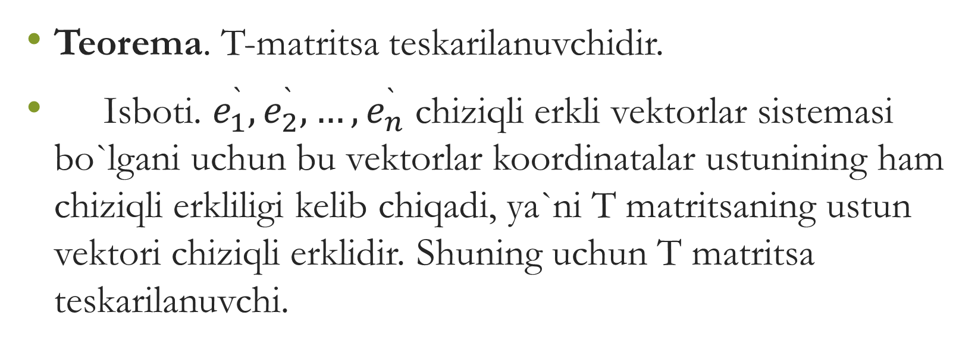
Teorema. T-matritsa teskarilanuvchidir.
Isboti. $e_{1}^{`},e_{2}^{`},…,e_{n}^{`}$ chiziqli erkli vektorlar sistemasi bo`lgani uchun bu vektorlar koordinatalar ustunining ham chiziqli erkliligi kelib chiqadi, ya`ni T matritsaning ustun vektori chiziqli erklidir. Shuning uchun T matritsa teskarilanuvchi.

Slide 12
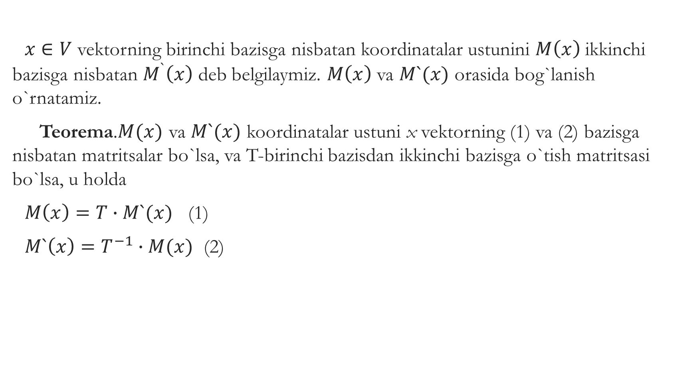
$x∈V$ vektorning birinchi bazisga nisbatan koordinatalar ustunini $M\left(x\right)$ ikkinchi bazisga nisbatan $M^{`}\left(x\right)$ deb belgilaymiz. $M\left(x\right)$ va $M`(x)$ orasida bog`lanish o`rnatamiz.
Teorema.$M(x)$ va $M`(x)$ koordinatalar ustuni x vektorning (1) va (2) bazisga nisbatan matritsalar bo`lsa, va T-birinchi bazisdan ikkinchi bazisga o`tish matritsasi bo`lsa, u holda
$M\left(x\right)=T∙M`(x)$ (1)
$M`\left(x\right)=T^{−1}∙M(x)$ (2)

Slide 13
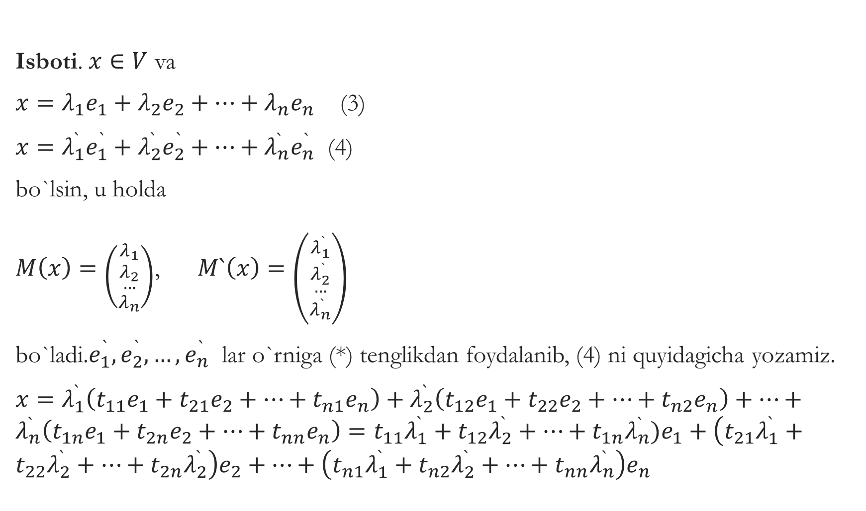
Isboti. $x∈V$ va
$x=λ_{1}e_{1}+λ_{2}e_{2}+…+λ_{n}e_{n}$ (3)
$x=λ_{1}^{`}e_{1}^{`}+λ_{2}^{`}e_{2}^{`}+…+λ_{n}^{`}e_{n}^{`}$ (4)
bo`lsin, u holda
$M\left(x\right)=\left({λ_{1} \atop \begin{aligned}λ_{2} \\ … \\ λ_{n}\end{aligned}}\right)$, $M`\left(x\right)=\left({λ_{1}^{`} \atop \begin{aligned}λ_{2}^{`} \\ … \\ λ_{n}^{`}\end{aligned}}\right)$
bo`ladi.$e_{1}^{`},e_{2}^{`},…,e_{n}^{`}$ lar o`rniga (*) tenglikdan foydalanib, (4) ni quyidagicha yozamiz.
$x=λ_{1}^{`}\left(t_{11}e_{1}+t_{21}e_{2}+…+t_{n1}e_{n}\right)+λ_{2}^{`}\left(t_{12}e_{1}+t_{22}e_{2}+…+t_{n2}e_{n}\right)+…+λ_{n}^{`}\left(t_{1n}e_{1}+t_{2n}e_{2}+…+t_{nn}e_{n}\right)=t_{11}λ_{1}^{`}+t_{12}λ_{2}^{`}+…+t_{1n}λ_{n}^{`})e_{1}+\left(t_{21}λ_{1}^{`}+t_{22}λ_{2}^{`}+…+t_{2n}λ_{2}^{`}\right)e_{2}+…+\left(t_{n1}λ_{1}^{`}+t_{n2}λ_{2}^{`}+…+t_{nn}λ_{n}^{`}\right)e_{n}$

Slide 14

Bundan
$$λ_{1}=t_{11}λ_{1}^{`}+t_{12}λ_{2}^{`}+…+t_{1n}λ_{n}^{`}$$
$$λ_{2}=t_{21}λ_{1}^{`}+t_{22}λ_{2}^{`}+…+t_{2n}λ_{n}^{`}$$
...............................................
$$λ_{n}=t_{n1}λ_{1}^{`}+t_{n2}λ_{2}^{`}+…+t_{nn}λ_{n}^{`}$$
bu yerdan
$$\left({λ_{1} \atop \begin{aligned}λ_{2} \\ … \\ λ_{n}\end{aligned}}\right)=\left({t_{11} t_{12}…{ t}_{1n} \atop \begin{aligned}t_{21} t_{12}… t_{2n} \\ ……………… \\ t_{1n} t_{2n}… t_{nn}\end{aligned}}\right)∙\left({λ_{1}^{`} \atop \begin{aligned}λ_{2}^{`} \\ … \\ λ_{n}^{`}\end{aligned}}\right)$$
ya`ni
$M\left(x\right)=T∙M`(x)$ bu tenglikning ikkala tomonini $T^{−1}$ ga ko`paytirib,
$M`\left(x\right)=T^{−1}∙M(x)$ ga ega bo`lamiz.

Slide 15
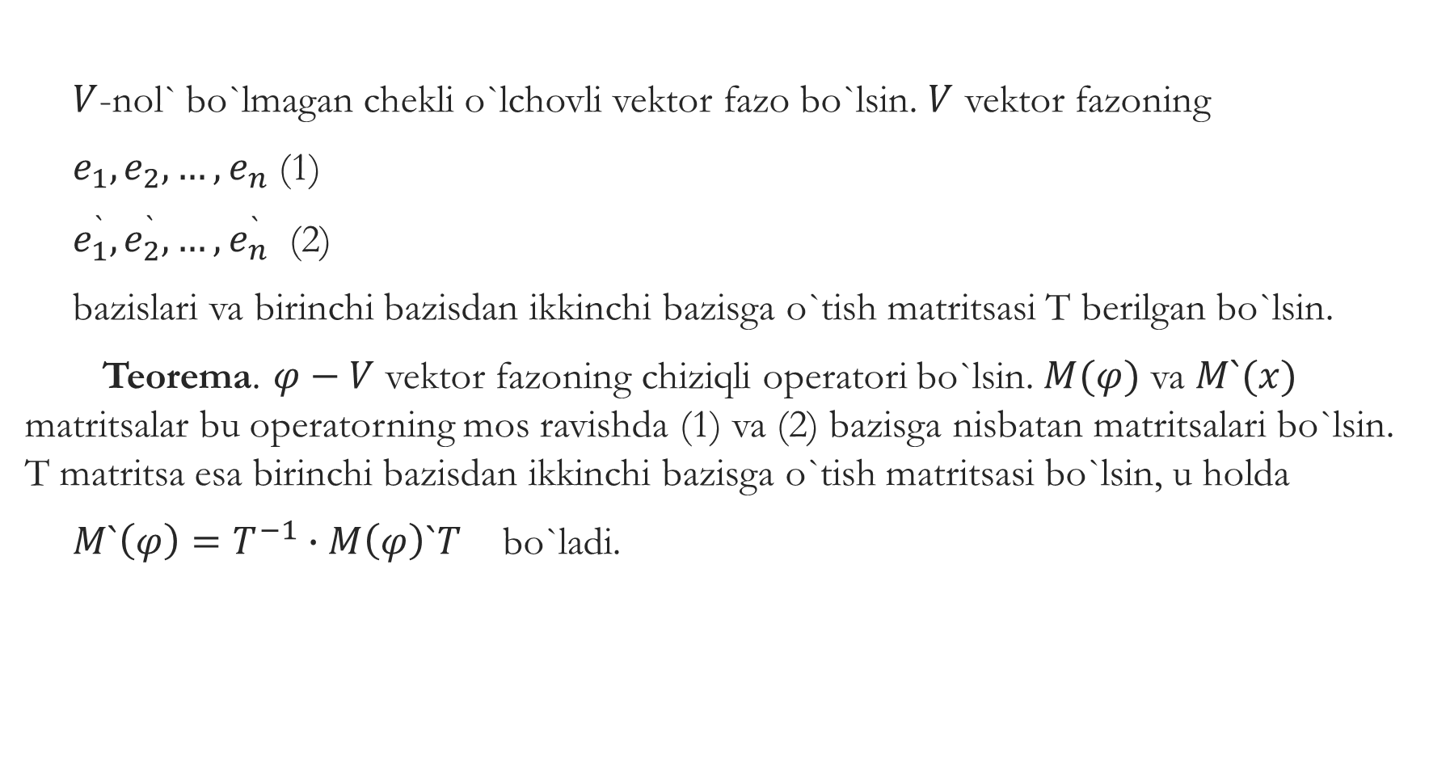
$V$-nol` bo`lmagan chekli o`lchovli vektor fazo bo`lsin. $V$ vektor fazoning
$e_{1},e_{2},…,e_{n}$ (1)
$e_{1}^{`},e_{2}^{`},…,e_{n}^{`}$ (2)
bazislari va birinchi bazisdan ikkinchi bazisga o`tish matritsasi T berilgan bo`lsin.
Teorema. $φ−V$ vektor fazoning chiziqli operatori bo`lsin. $M(φ)$ va $M`(x)$ matritsalar bu operatorning mos ravishda (1) va (2) bazisga nisbatan matritsalari bo`lsin. T matritsa esa birinchi bazisdan ikkinchi bazisga o`tish matritsasi bo`lsin, u holda
$M`\left(φ\right)=T^{−1}∙M\left(φ\right)`T$ bo`ladi.

Slide 16
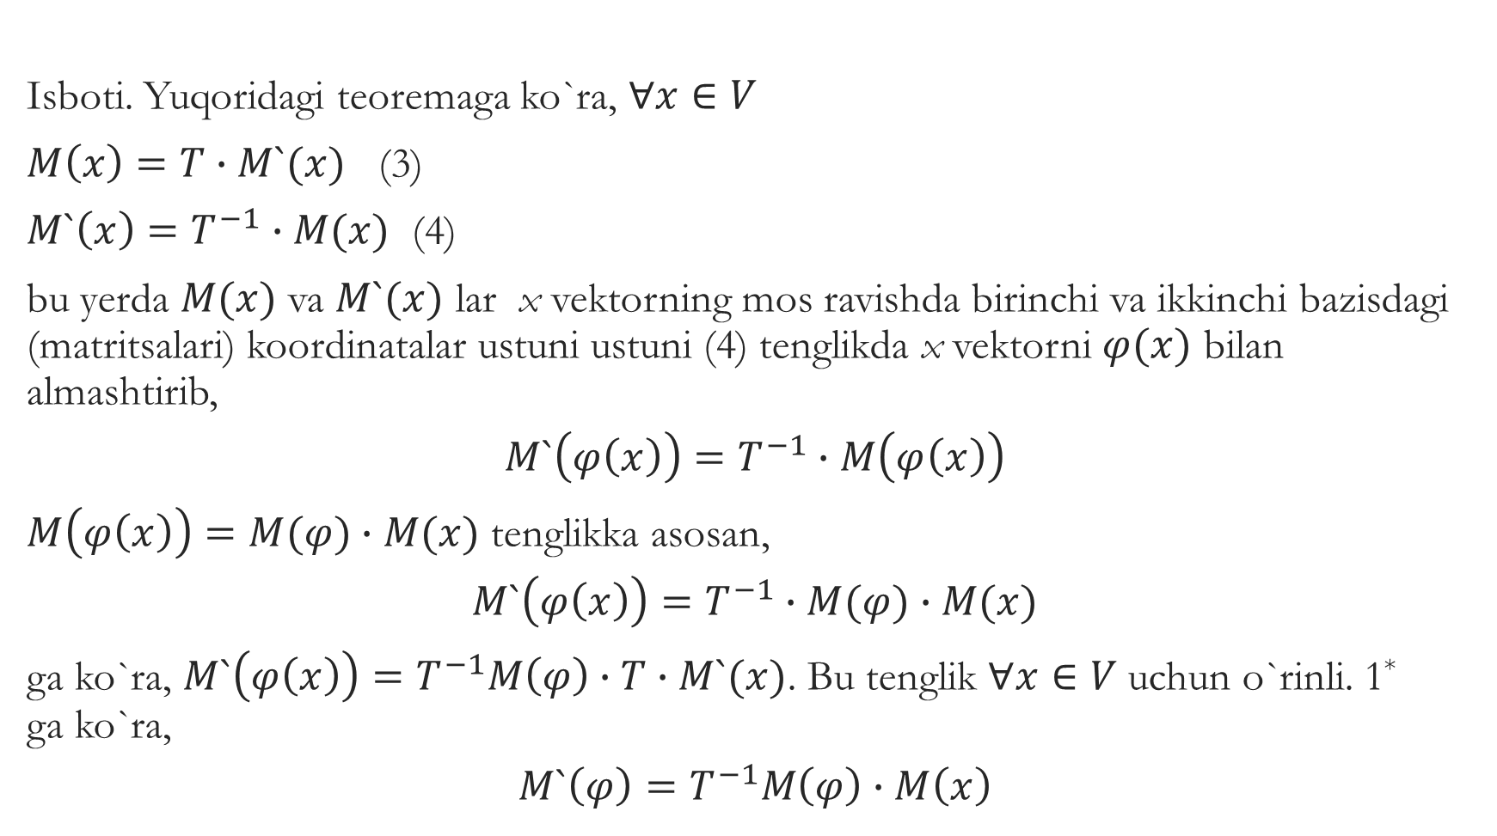
Isboti. Yuqoridagi teoremaga ko`ra, $∀x∈V$
$M\left(x\right)=T∙M`(x)$ (3)
$M`\left(x\right)=T^{−1}∙M(x)$ (4)
bu yerda $M(x)$ va $M`(x)$ lar x vektorning mos ravishda birinchi va ikkinchi bazisdagi (matritsalari) koordinatalar ustuni ustuni (4) tenglikda x vektorni $φ(x)$ bilan almashtirib,
$$M`\left(φ\left(x\right)\right)=T^{−1}∙M\left(φ\left(x\right)\right)$$
$M\left(φ\left(x\right)\right)=M(φ)∙M(x)$ tenglikka asosan,
$$M`\left(φ\left(x\right)\right)=T^{−1}∙M(φ)∙M(x)$$
ga ko`ra, $M`\left(φ\left(x\right)\right)=T^{−1}M\left(φ\right)∙T∙M`(x)$. Bu tenglik $∀x∈V$ uchun o`rinli. 1*
ga ko`ra,
$$M`\left(φ\right)=T^{−1}M\left(φ\right)∙M\left(x\right)$$

Slide 17
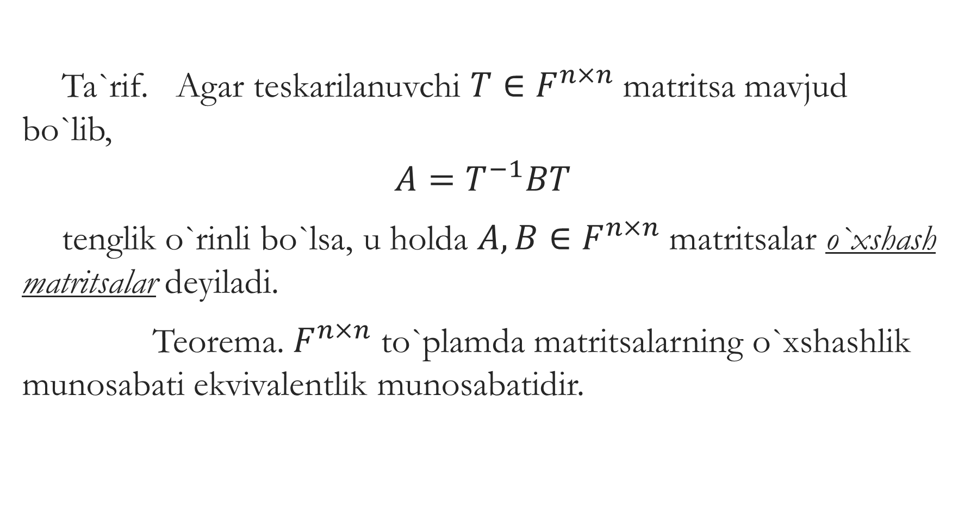
Ta`rif. Agar teskarilanuvchi $T∈F^{n×n}$ matritsa mavjud bo`lib,
$$A=T^{−1}BT$$
tenglik o`rinli bo`lsa, u holda $A,B∈F^{n×n}$ matritsalar o`xshash matritsalar deyiladi.
Teorema. $F^{n×n}$ to`plamda matritsalarning o`xshashlik munosabati ekvivalentlik munosabatidir.

