Slide 1
Chiziqli algebralar
Reja:
Chiziqlialgebra haqida tushunchalar.
Chiziqli algebraga misollar.
Chiziqli operatorlar algebrasi.
Matritsalar algebrasi.
Chiziqli operatorlar algebrasi va matritsalar algebrasi orasidagi izomorfizm.

Slide 2
ℱ maydon ustida V_{n} vector fazoberilgan bo’lib,
(1)
Uning biror bazisi va φ operator berilgan V_{n} fazoning chiziql ioperatori bo’lsin. vaφ( ) vektorlarning (1) bazis orqali , ko’rinishda ifodalansin.
vaφ( ) vektorlarning (1) bazisga nisbatan ustun koordinatalarini mos ravishda ushbu
ko’rinishlarda belgilab, ular orasidagi bog’lanish formulasini keltirib chiqaraylik.

Slide 3
Teorema. Agar ф operator V_{n}fazoda aniqlangan chiziqli operator bo’lib, M(φ) shu φ chiziqli operatorning (1) bazisdagi matritsasi bo’lsa, u holda∀ ∈V_{n}uchun M(φ( ))=M(φ)M( ) tenglik bajariladi.
Ta’rif.ℱ maydon ustidagi V chiziqli fazo elementlari uchun quyidagi aksiomalar bajarilsa,
uholda V fazoniℱmaydonustidagichiziqli algebra deyiladi.
Ta’rif.Agar V chiziqlialgebrada aksiomabajarilsa, V kommutativchiziqli algebra deyiladi.
Ta’rif.V chiziqlialgebraningrangi deb V fazoningo’lchovigaaytiladi.

Slide 4
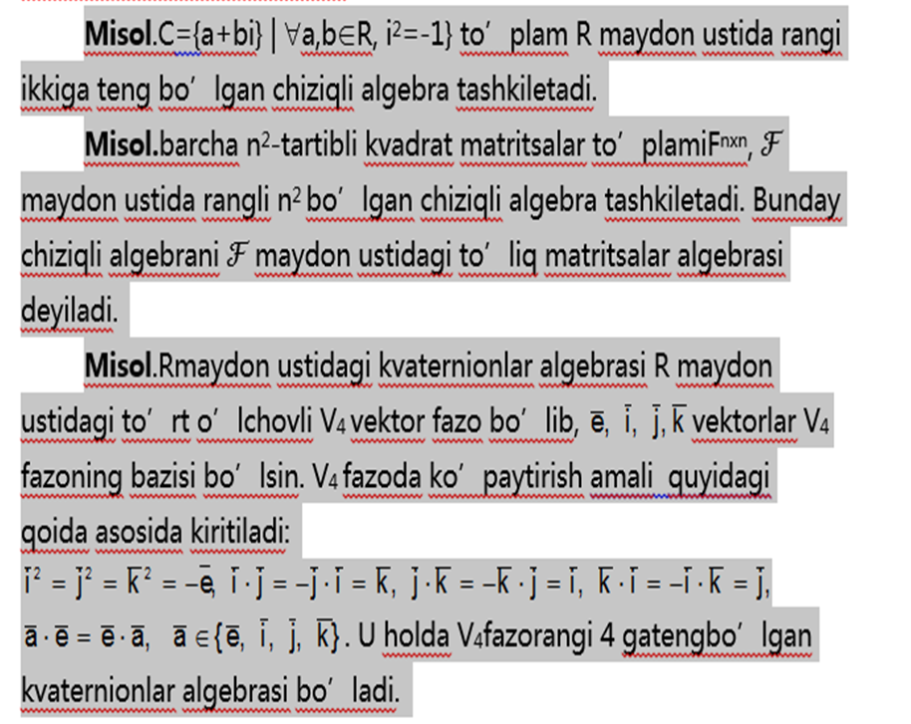

Slide 5
Lemma. V vektor fazoning ixtiyoriy ikkita chiziqli operatorlari ko’paytmasi yana shu vektor fazoning chiziqli operatori bo’ladi.
Bizga ma’lumki Hom (V,V) to’plam ℱ maydon ustida vektor fazo tashkil qiladi.
Ushbu algebrani <Hom (V,V), +, ,•> algebra V vektor fazoning chiziqli operatorlar algebrasi deyiladi va quyidagicha belgilanadi:
End V= <Hom (V,V), +, ,•>
Teorema.Agar V fazo ℱ maydon ustidagi vektor fazo bo’lsa, u holda End V algebra ℱ maydon ustida chiziqli algebra tashkil qiladi.
Isboti.EndV algebra chiziqli algebra shartlarini to’liq bajaradi. Haqiqatan,
<Hom (V,V), +, ,•> algebra ℱmaydonustidavektor
fazotashkilqiladi;
2.
3.
4.

Slide 6
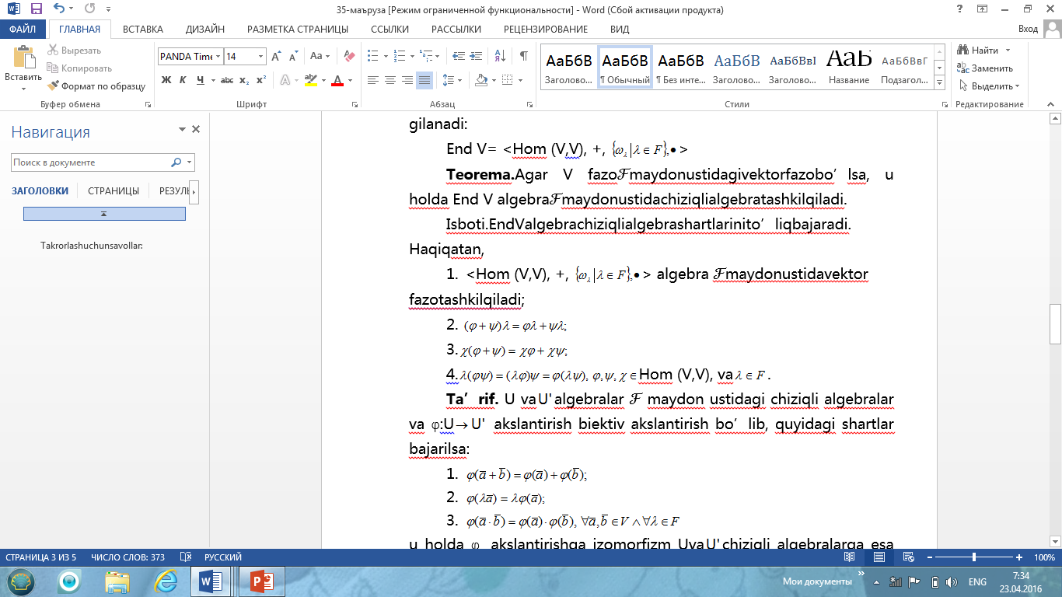

Slide 7
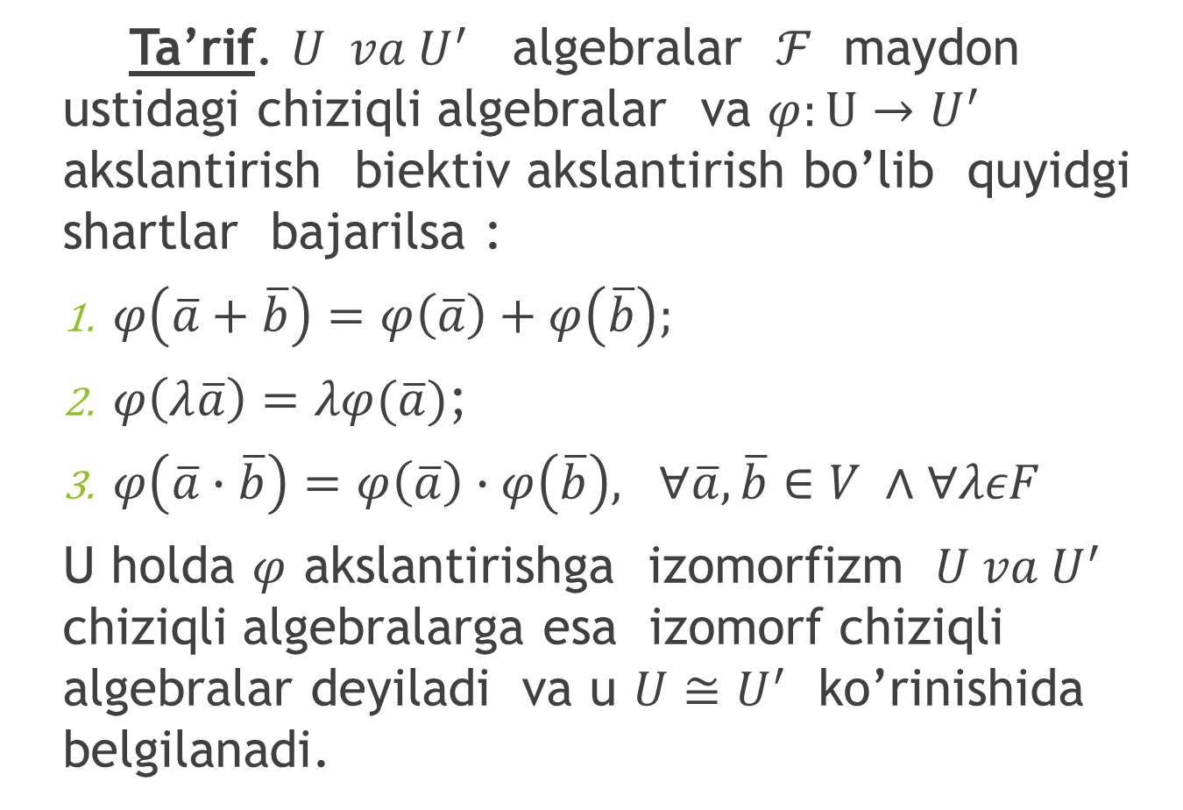
Ta’rif. $U va U^{′}$ algebralar $ℱ$ maydon ustidagi chiziqli algebralar va $φ:U→U^{′}$ akslantirish biektiv akslantirish bo’lib quyidgi shartlar bajarilsa :
$φ\left(\overline{a}+\overline{b}\right)=φ\left(\overline{a}\right)+φ\left(\overline{b}\right);$
$φ\left(λ\overline{a}\right)=λφ(\overline{a})$;
$φ\left(\overline{a}∙\overline{b}\right)=φ\left(\overline{a}\right)∙φ\left(\overline{b}\right), ∀\overline{a},\overline{b}∈V ∧∀λεF$
U holda $φ$ akslantirishga izomorfizm $U va U^{′}$ chiziqli algebralarga esa izomorf chiziqli algebralar deyiladi va u $U≅U^{′}$ ko’rinishida belgilanadi.

Slide 8
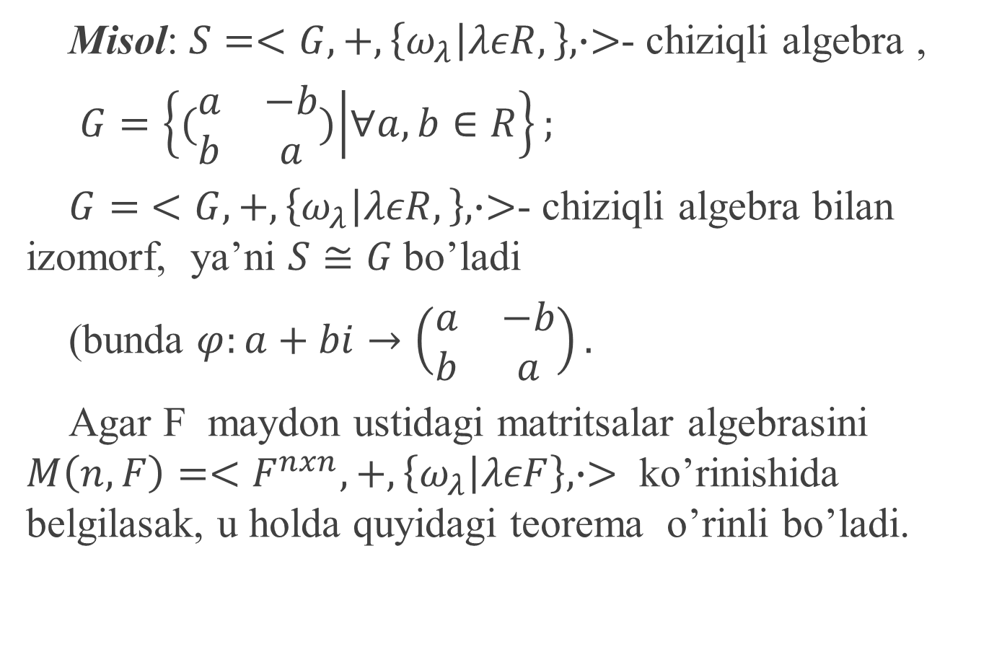
Misol: $S=<G,+,\left\{ω_{λ} | λεR,\right\}, ∙>$- chiziqli algebra ,
$G=\left\{(\begin{matrix}a & −b \\ b & a\end{matrix}) | ∀a,b∈R\right\};$
$G=$ $<G,+,\left\{ω_{λ} | λεR,\right\}, ∙>$- chiziqli algebra bilan izomorf, ya’ni $S≅G$bo’ladi
(bunda $φ:a+bi→\left(\begin{matrix}a & −b \\ b & a\end{matrix}\right).$
Agar F maydon ustidagi matritsalar algebrasini $M\left(n,F\right)=<F^{nxn},+,\left\{ω_{λ} | λεF\right\},∙>$ ko’rinishida belgilasak, u holda quyidagi teorema o’rinli bo’ladi.

Slide 9
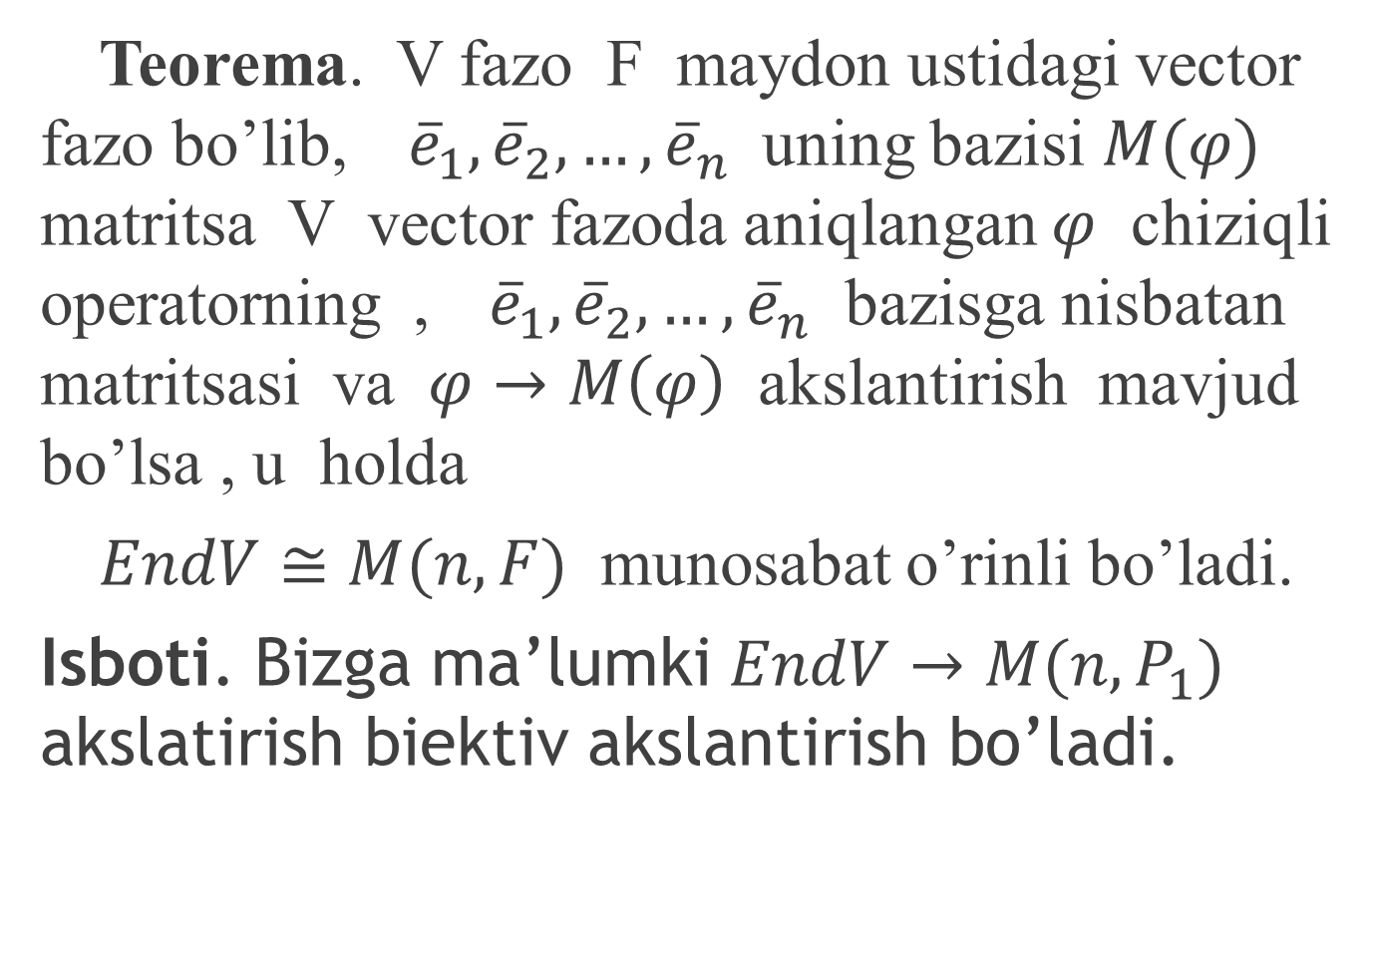
Teorema. V fazo F maydon ustidagi vector fazo bo’lib,${\overline{e}}_{1},{\overline{e}}_{2},…,{\overline{e}}_{n}$ uning bazisi $M(φ)$ matritsa V vector fazoda aniqlangan $φ$ chiziqli operatorning ,${\overline{e}}_{1},{\overline{e}}_{2},…,{\overline{e}}_{n}$ bazisga nisbatan matritsasi va $φ→M\left(φ\right)$ akslantirish mavjud bo’lsa , u holda
$EndV≅M(n,F)$ munosabat o’rinli bo’ladi.
Isboti. Bizga ma’lumki $EndV→M(n,P_{1})$ akslatirish biektiv akslantirish bo’ladi.

Slide 10
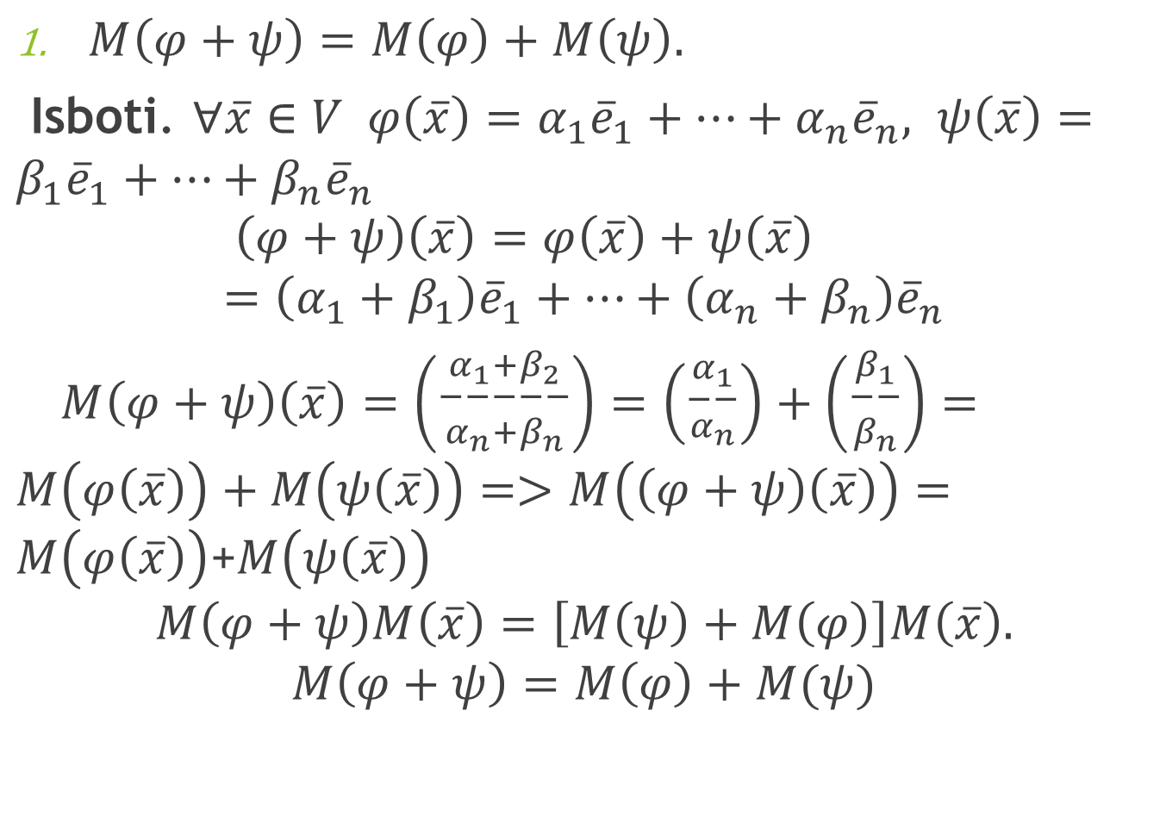
$M\left(φ+ψ\right)=M\left(φ\right)+M\left(ψ\right).$
Isboti. $∀\overline{x}∈V φ\left(\overline{x}\right)=α_{1}{\overline{e}}_{1}+…+α_{n}{\overline{e}}_{n}, ψ\left(\overline{x}\right)=β_{1}{\overline{e}}_{1}+…+β_{n}{\overline{e}}_{n}$
$$\left(φ+ψ\right)\left(\overline{x}\right)=φ\left(\overline{x}\right)+ψ\left(\overline{x}\right)=\left(α_{1}+β_{1}\right){\overline{e}}_{1}+…+\left(α_{n}+β_{n}\right){\overline{e}}_{n}$$
$M\left(φ+ψ\right)\left(\overline{x}\right)=\left({\begin{aligned}α_{1}+β_{2} \\ −−−−−\end{aligned} \atop α_{n}+β_{n}}\right)=\left({\begin{aligned}α_{1} \\ −−\end{aligned} \atop α_{n}}\right)+\left({\begin{aligned}β_{1} \\ −−\end{aligned} \atop β_{n}}\right)=M\left(φ\left(\overline{x}\right)\right)+M\left(ψ\left(\overline{x}\right)\right)=>M\left(\left(φ+ψ\right)\left(\overline{x}\right)\right)=M\left(φ\left(\overline{x}\right)\right)$+$M\left(ψ\left(\overline{x}\right)\right)$
$$M\left(φ+ψ\right)M\left(\overline{x}\right)=\left[M\left(ψ\right)+M\left(φ\right)\right]M\left(\overline{x}\right).$$
$$M\left(φ+ψ\right)=M\left(φ\right)+M(ψ)$$

Slide 11
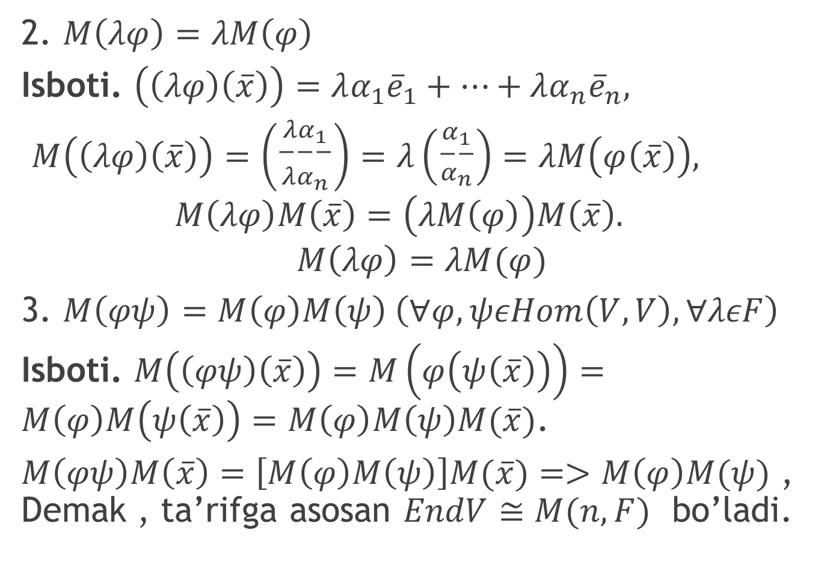
2. $M\left(λφ\right)=λM\left(φ\right)$
Isboti. $\left(\left(λφ\right)\left(\overline{x}\right)\right)=λα_{1}{\overline{e}}_{1}+…+λα_{n}{\overline{e}}_{n},$
$M\left(\left(λφ\right)\left(\overline{x}\right)\right)=\left({\begin{aligned}λα_{1} \\ −−−\end{aligned} \atop λα_{n}}\right)=λ\left({\begin{aligned}α_{1} \\ −−\end{aligned} \atop α_{n}}\right)=λM\left(φ\left(\overline{x}\right)\right),$
$$M\left(λφ\right)M\left(\overline{x}\right)=\left(λM\left(φ\right)\right)M\left(\overline{x}\right).$$
$$M\left(λφ\right)=λM(φ)$$
3. $M\left(φψ\right)=M\left(φ\right)M\left(ψ\right) \left(∀φ,ψεHom\left(V,V\right),∀λεF\right)$
Isboti. $M\left(\left(φψ\right)\left(\overline{x}\right)\right)=M\left(φ\left(ψ\left(\overline{x}\right)\right)\right)=M\left(φ\right)M\left(ψ\left(\overline{x}\right)\right)=M\left(φ\right)M\left(ψ\right)M(\overline{x})$.
$M\left(φψ\right)M\left(\overline{x}\right)=\left[M\left(φ\right)M\left(ψ\right)\right]M(\overline{x})=>M\left(φ\right)M(ψ)$ , Demak , ta’rifga asosan $EndV≅M(n,F)$ bo’ladi.

Slide 12
Takrorlash uchun savollar:
Chiziqli algebra deb nimaga aytiladi?
Chiziqli algebraga misollar keltiring.
Chiziqli operatorlar algebrasi deb nimaga aytiladi?
Matritsalar algebrasi deb nimaga aytiladi?
Algebralar izomorfizmi haqida teoramani bayon qiling.

